Slide 1
How to read an economics paper

Slide 2
Components
Title
Abstract
Introduction
Data/background
Model
Results
Robustness analysis
Conclusion
Appendix

Slide 3
Read a paper
First read
Existing literature
Abstract
Introduction
Conclusion
Other things to take care
Data
Model specific
Robustness checks

Slide 4
Title & Abstract & Key words
Existing research
What is the study about
What method does it use
What is the main results
What are the implications

Slide 5
Title & Abstract & Key words
Existing studies establish a strong cross-country correlation between income and democracy but do not control for factors that simultaneously affect both variables. We show that controlling for such factors by including country fixed effects removes the statistical association between income per capita and vari- ous measures of democracy. We present instrumental-variables estimates that also show no causal effect of income on democracy. The cross-country corre- lation between income and democracy reflects a positive correlation between changes in income and democracy over the past 500 years. This pattern is con- sistent with the idea that societies embarked on divergent political-economic development paths at certain critical junctures. (JEL D7, E1)

Slide 6
Title & Abstract & Key words
Existing studies establish a strong cross-country correlation between income and democracy but do not control for factors that simultaneously affect both variables.
We show that controlling for such factors by including country fixed effects removes the statistical association between income per capita and various measures of democracy. We present instrumental-variables estimates that also show no causal effect of income on democracy.
The cross-country correlation between income and democracy reflects a positive correlation between changes in income and democracy over the past 500 years. This pattern is consistent with the idea that societies embarked on divergent political-economic development paths at certain critical junctures. (JEL D7, E1)

Slide 7
Introduction
More detailed backgrounds
What do we do
More specific than the abstract

Slide 8
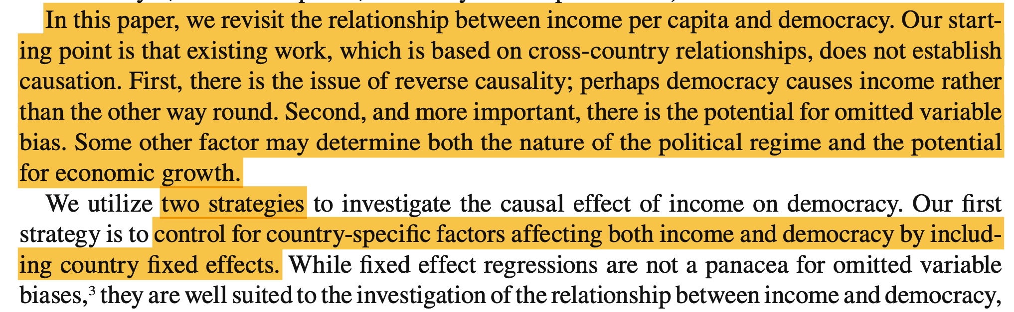
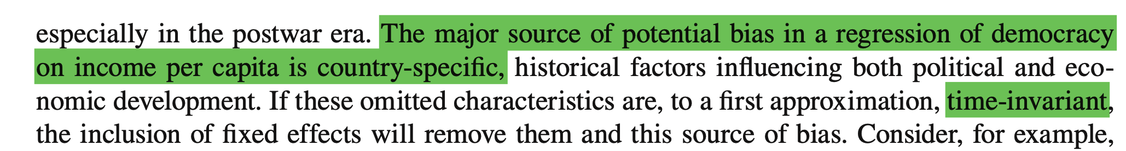
Introduction

Slide 9
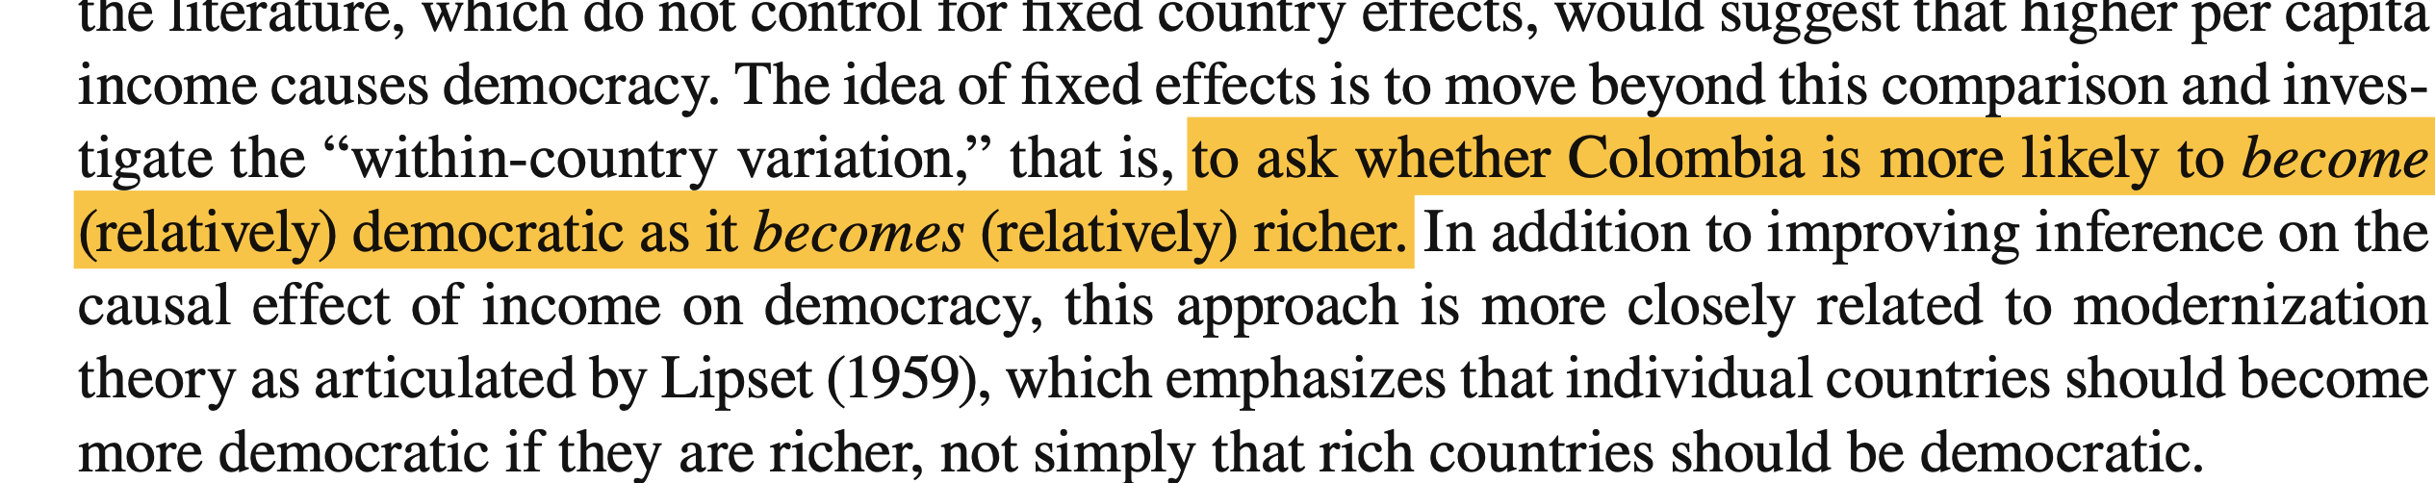
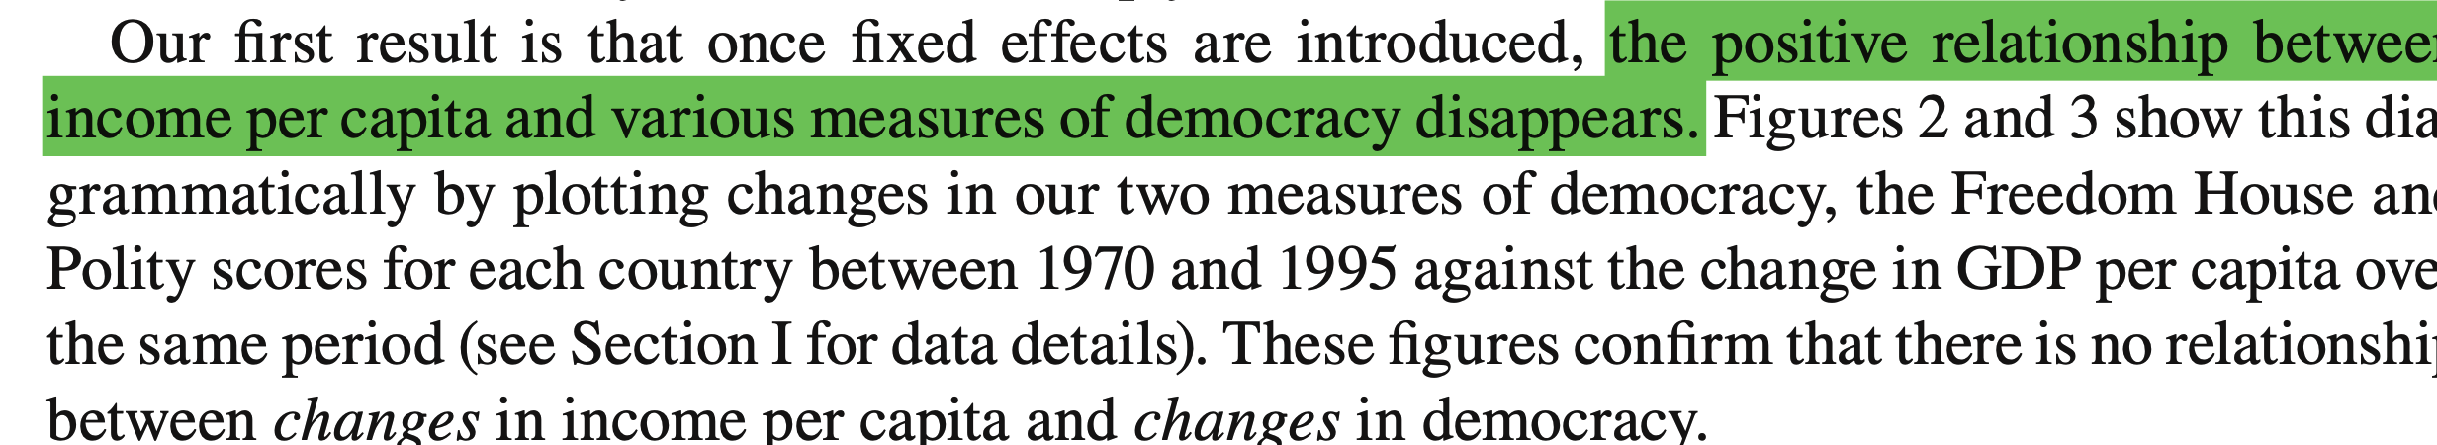
Introduction

Slide 10
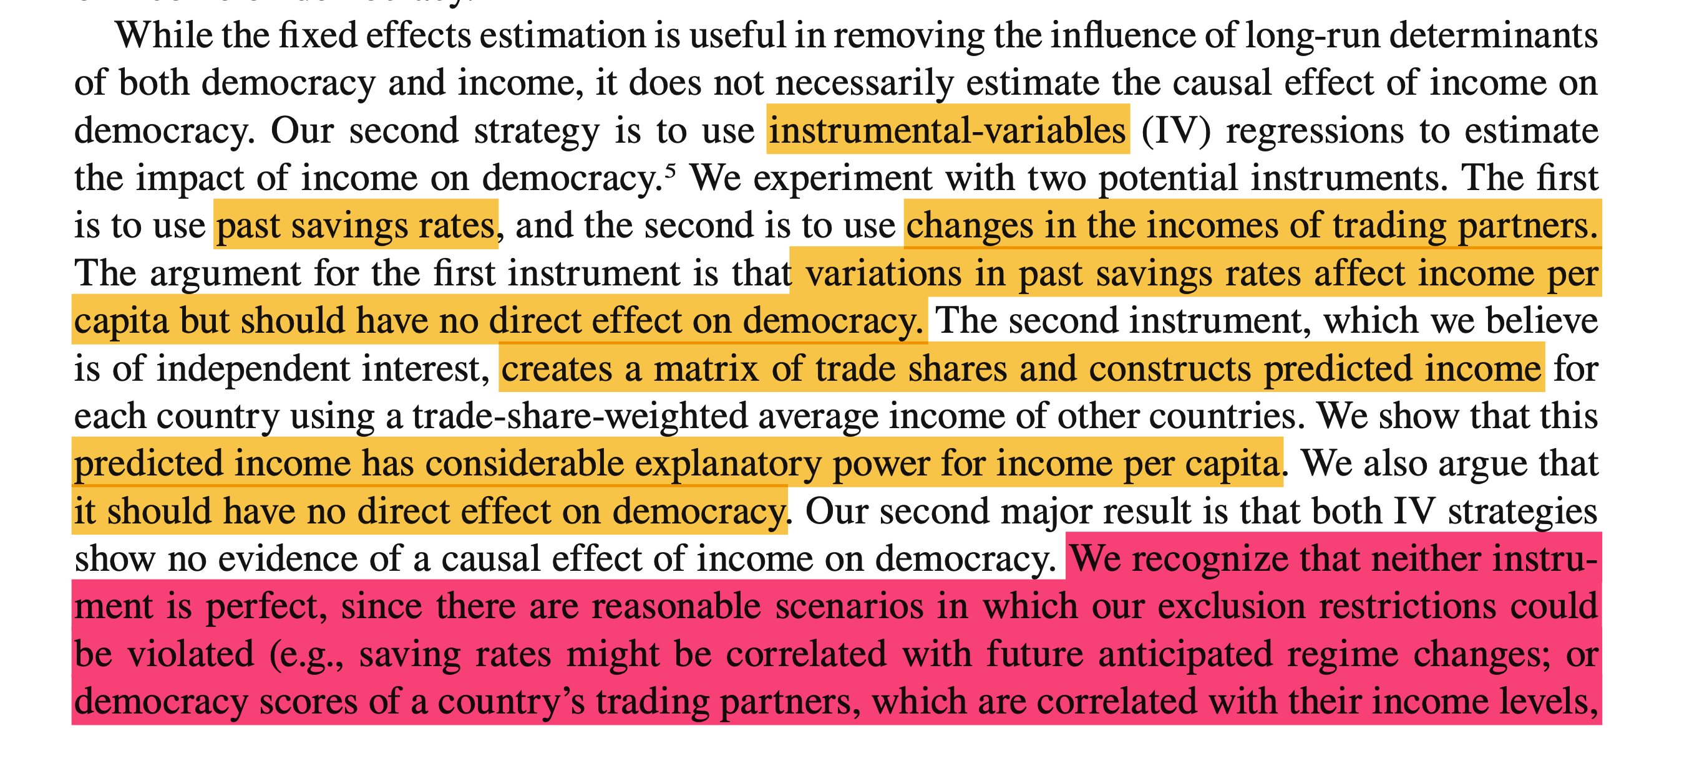
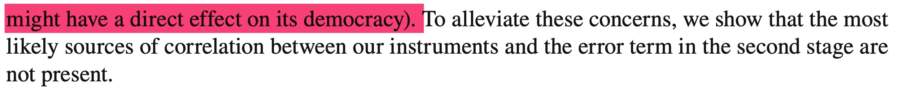
Relevance and Exclusion

Slide 11
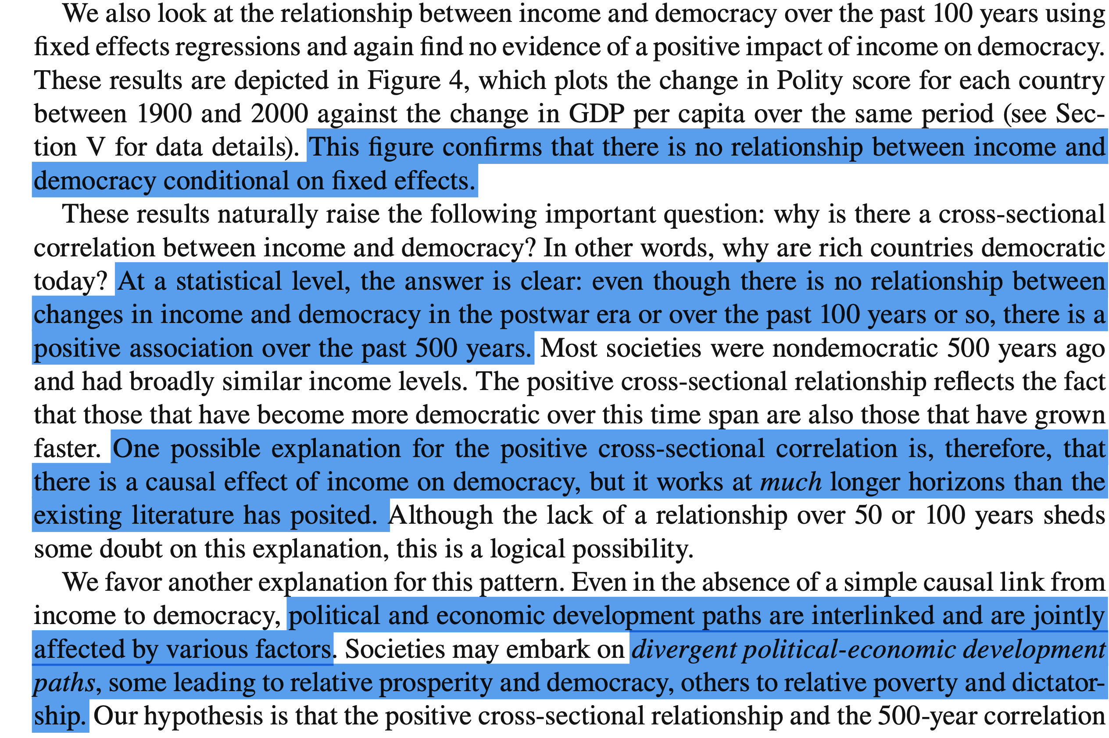
Implications

Slide 12
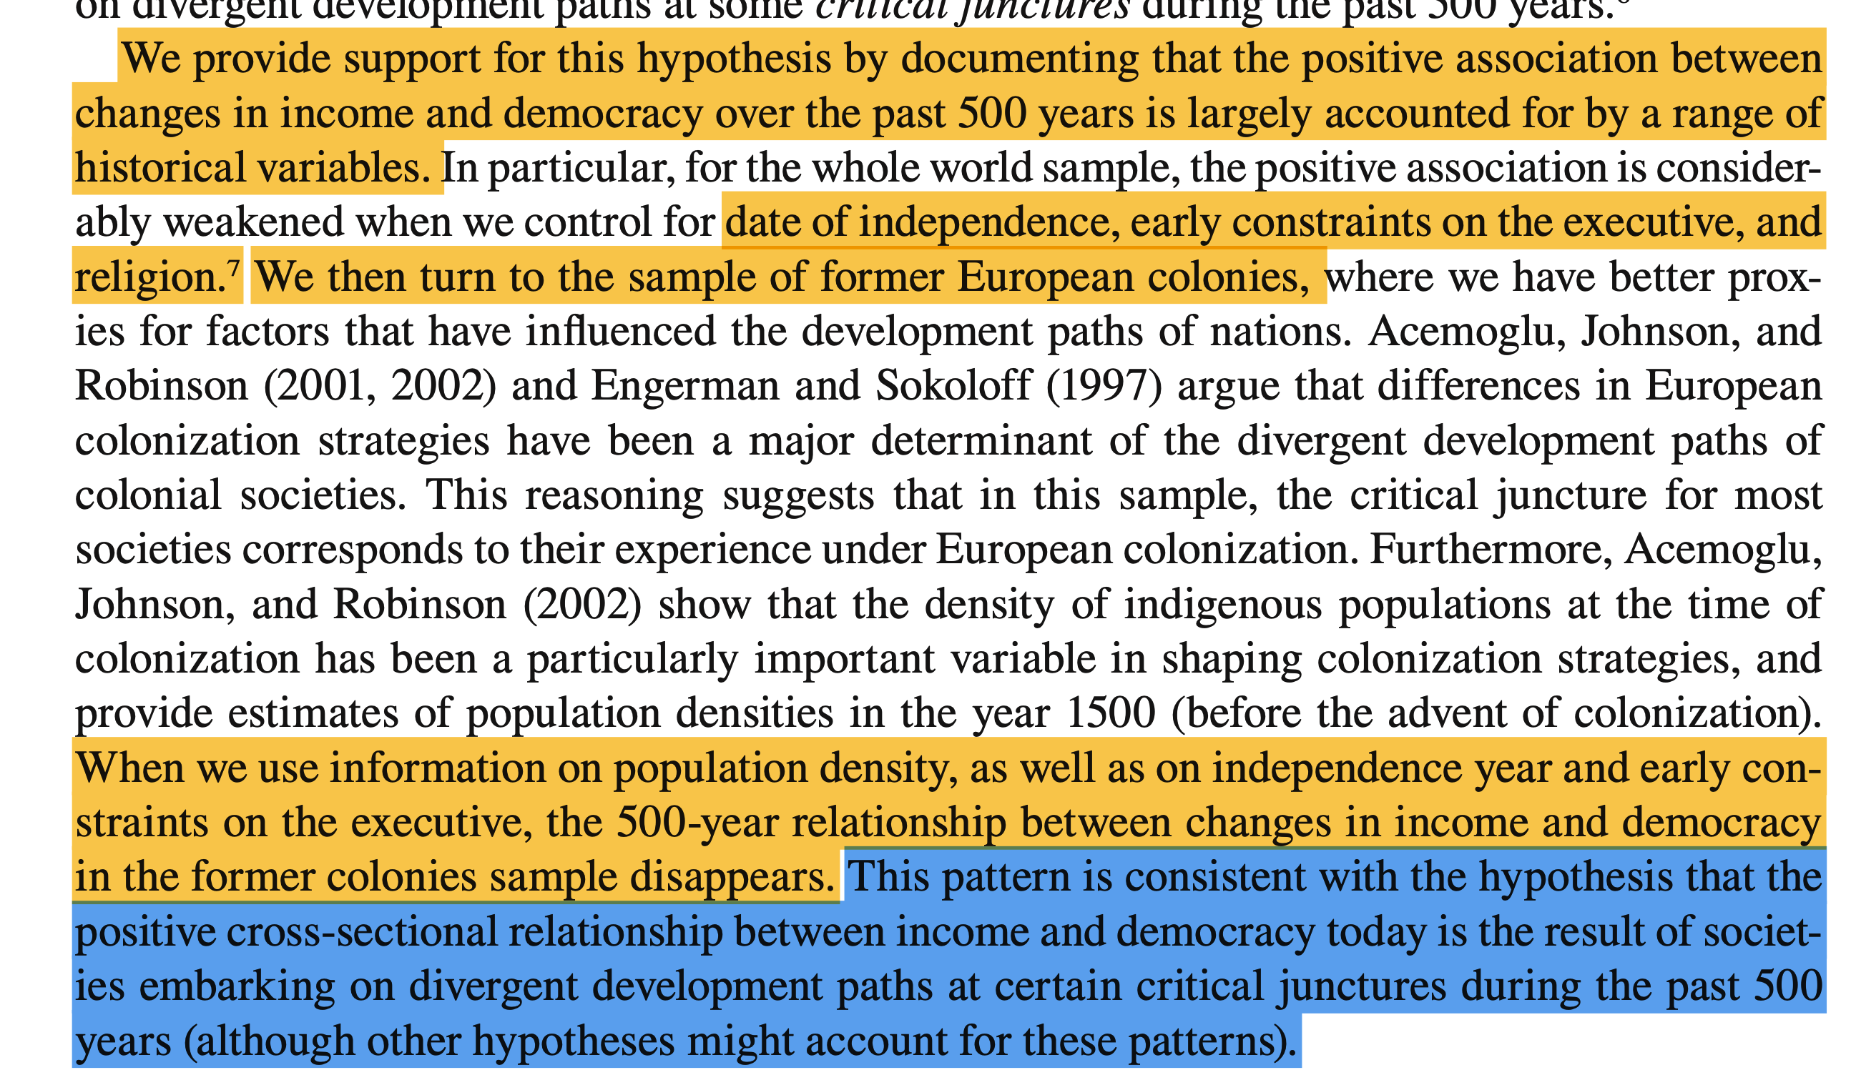
More ideas & Implications

Slide 13
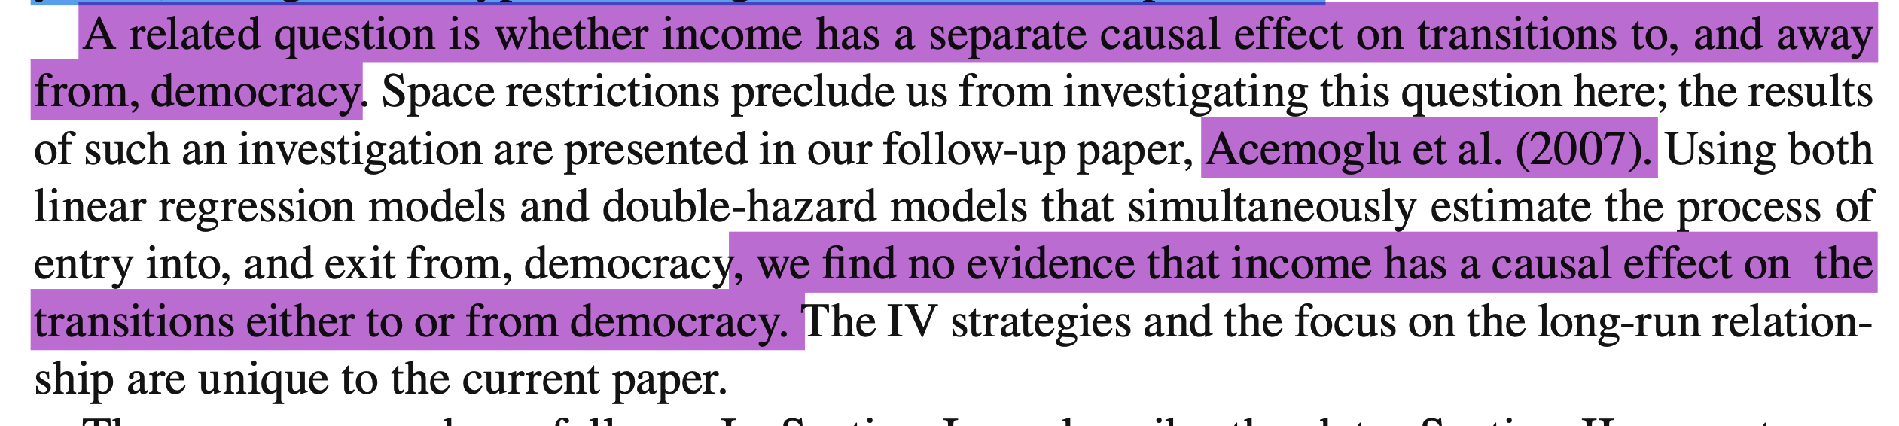
Future directions / link to working papers

Slide 14
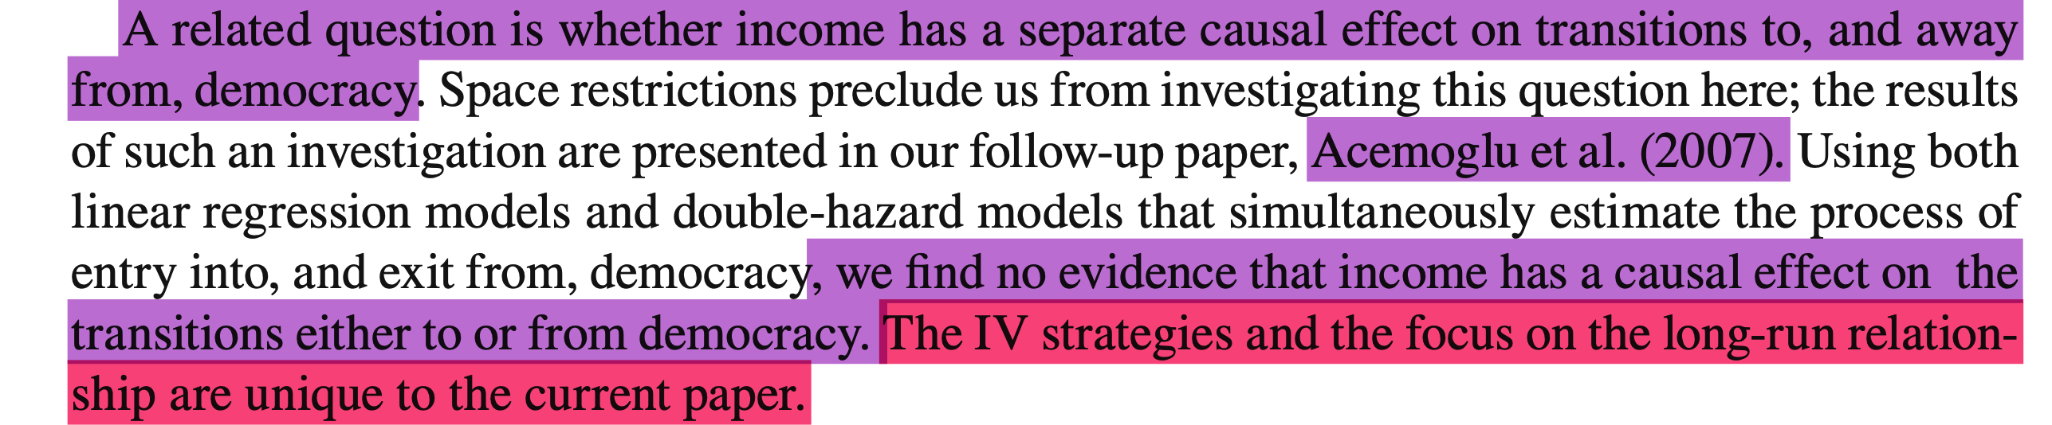
What is unique in the paper

Slide 15
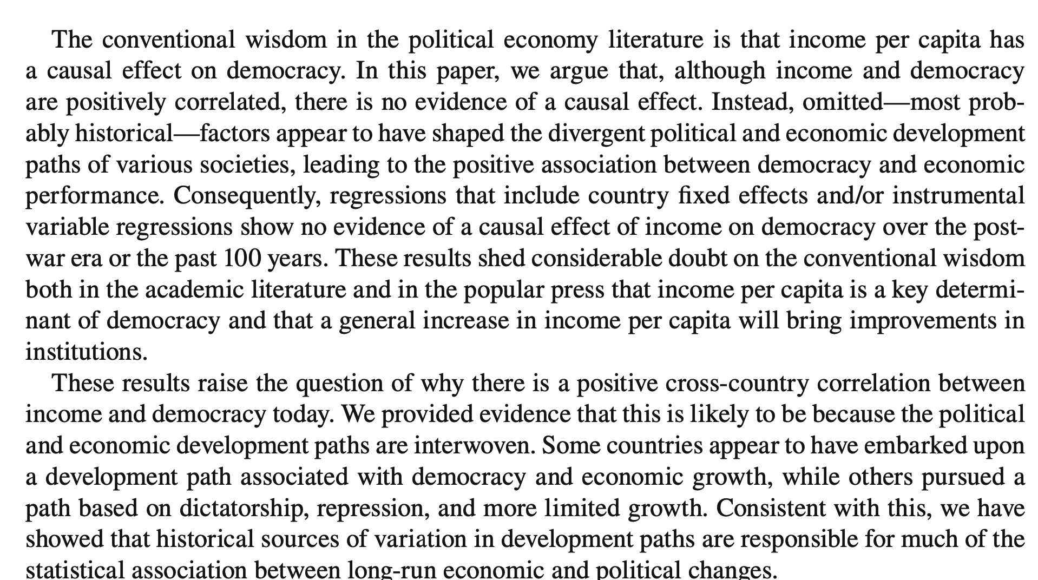
Conclusion

Slide 16
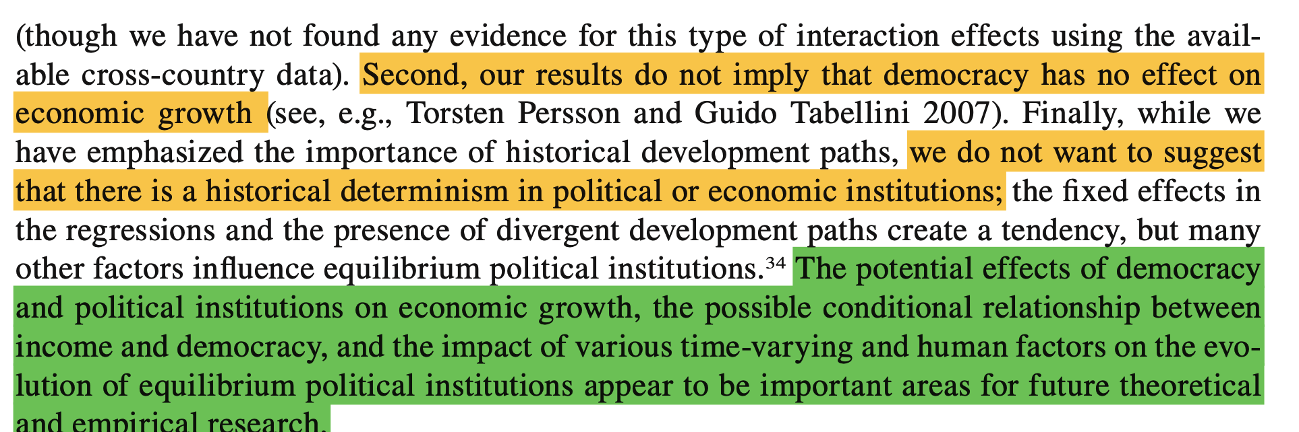
Conclusion – moving further

Slide 17
Read a paper
First read
Existing literature
Abstract
Introduction
Conclusion
Other things to take care
Data
Model specific
Robustness checks

Slide 18
Data
Why important?
What is the target population? Is it well fit for the question
Is the data from an external source
If yes
What is it?
Are newer data available or has the data source ended?
Are there adjustments made for this research?
If no
How is it collected?
How is the sample made?
Any limitations?

Slide 19
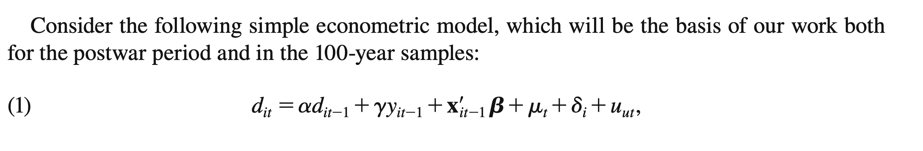
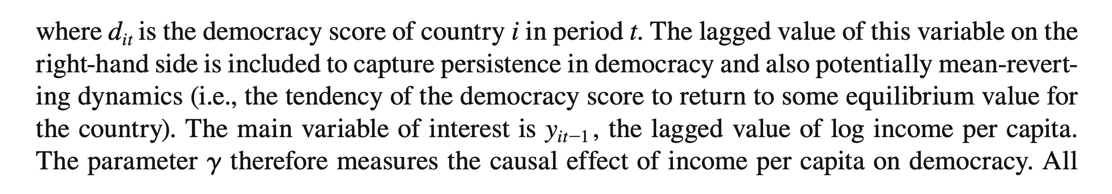
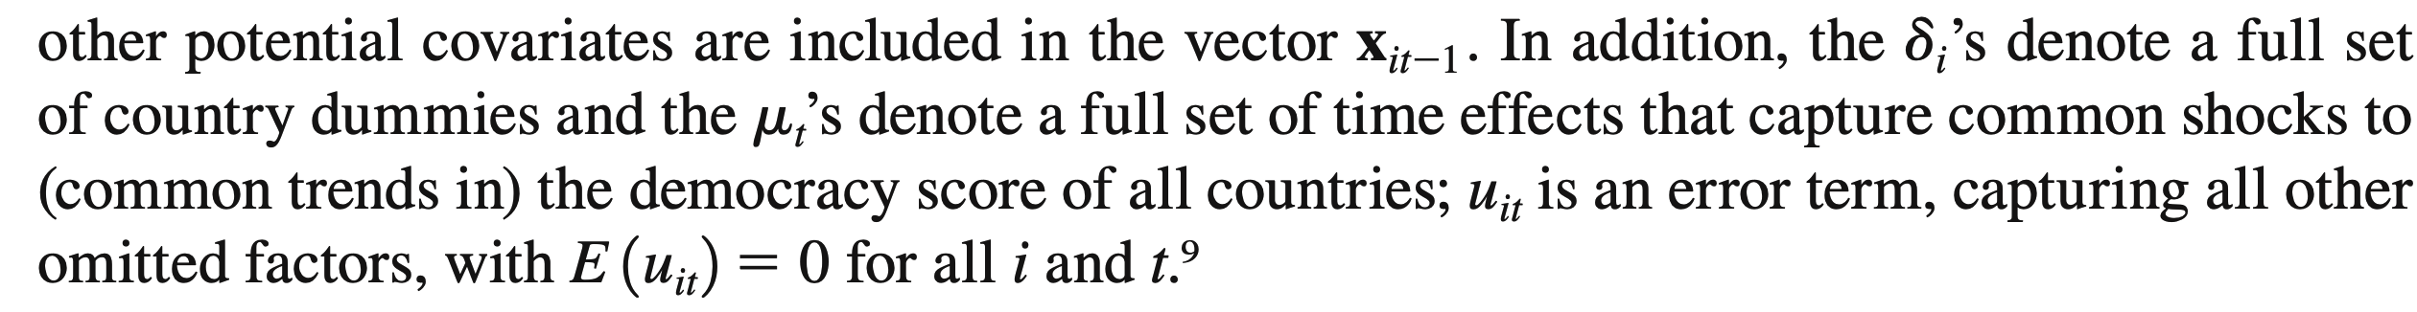
The model

